Slide 1

Your Company Name
Pitch Deck
SIMPLICITY IS THE ULTIMATE SOPHISTICATION
John Doe
Today's Date

Slide 2

Executive Summary
Your Vision and Value Proposition
A short overview of your business and the value that you provide to your potential customers. Keep it simple and clear.
02

Slide 3

The Problem
Problem 1
Introduce the problem to solve--make sure your audience can relate. Present it in a way that makes old solutions sound obsolete.
Define the problem you are trying to solve and who has is. What pain points are you trying to address? Why do you get out of bed in the morning?
Problem 2
Introduce the problem to solve--make sure your audience can relate. Present it in a way that makes old solutions sound obsolete.
Problem 3
Introduce the problem to solve--make sure your audience can relate. Present it in a way that makes old solutions sound obsolete.
03

Slide 4

The Solution
List 3 ways your company proposes to solve the problem. Adopt your customer's point of view when doing so. Use empathy.
Solution 1
Solution 2
Solution 3
Present one of your solutions if multiple; or a first step, feature, or pre-requisite if not.
Present one of your solutions if multiple; or a first step, feature, or pre-requisite if not.
Present one of your solutions if multiple; or a first step, feature, or pre-requisite if not.
04

Slide 5


Your Product or Service
Quick summary of what your product or service can do for your audience
Introduce the details of your product or service and how it'll help prospects solve their problem. Keep it high-level and easy to understand. Think elevator pitch.
05

Slide 6

Business Model & Revenue Streams
Revenue Stream 1
Revenue Stream 2
Revenue Stream 3
Describe how your product or service makes money, and what the expected revenues are.
Describe how your product or service makes money, and what the expected revenues are.
Describe how your product or service makes money, and what the expected revenues are.
10
10

Slide 7

Marketing & Sales Plan
Marketing Strategy
Sales Strategy
What is your marketing and sales plan? How you are planning to promote your product or service to prospective customers.
What is your marketing and sales plan? How you are planning to promote your product or service to prospective customers.

Slide 8



Competitive Advantages
Benefit 1
Benefit 2
Benefit 3
What makes your product or service special and different?
Make sure you are addressing your audience's problems.
Don't get technical--these should be high-level enough.
06

Slide 9




Competitive Analysis
Competitor 2
Why is your solution better than competitor's #2?
Define your main competitors and their alternative solutions to the problem you are planning to solve.
Competitor 1
Competitor 3
Why is your solution better than competitor's #1?
Why is your solution better than competitor's #3?

Slide 10
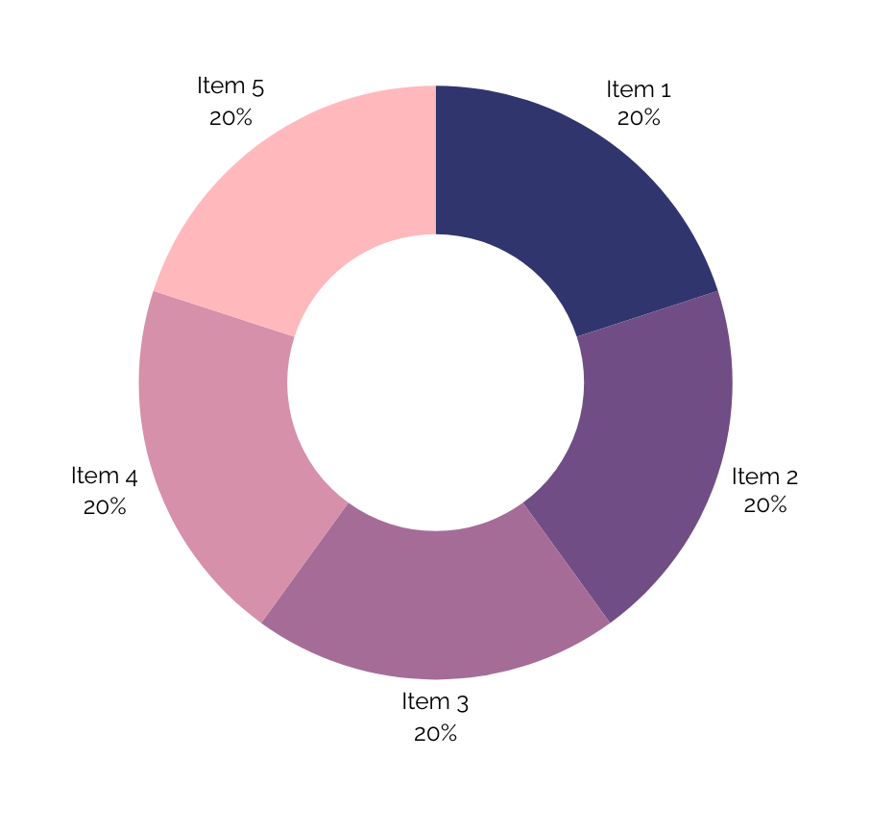
Target Market Opportunity
How big is the market your company is after?
Define your potential customers and the total size of your target market.
09

Slide 11
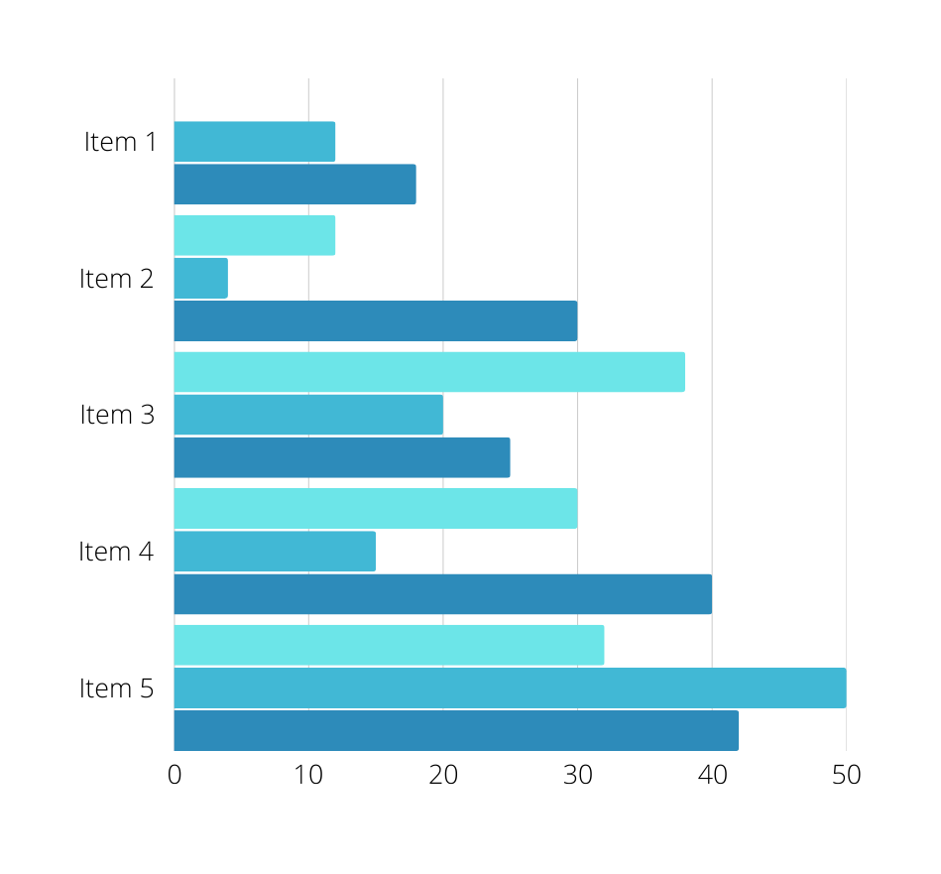
Target Market Opportunity
How big is the market your company is after?
Define your potential customers and the total size of your target market.
09

Slide 12
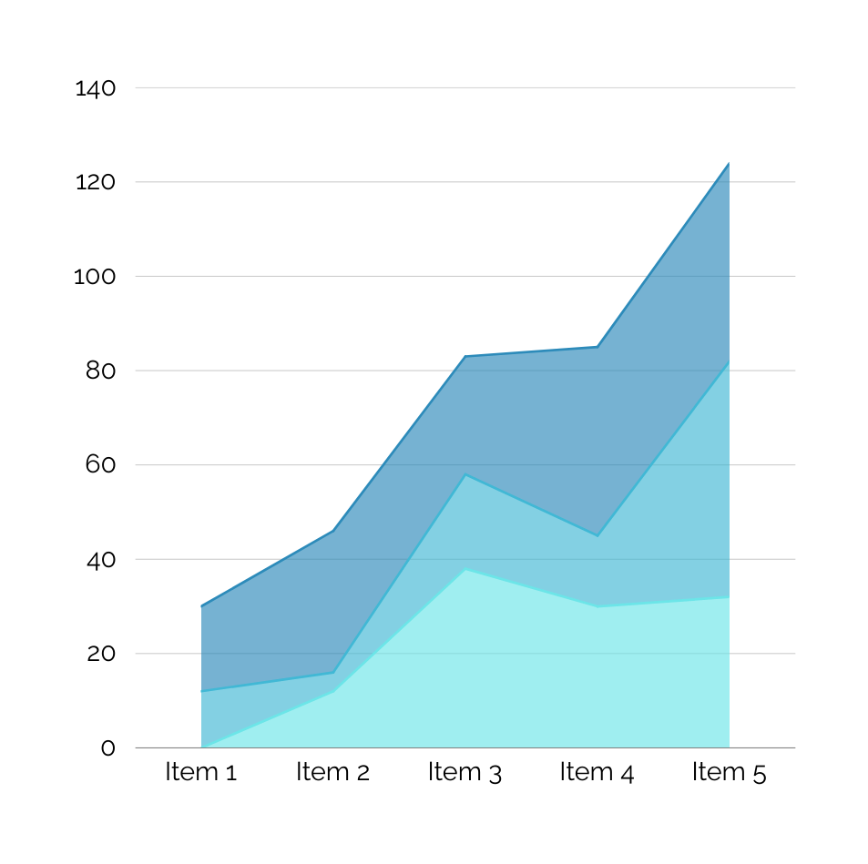
Target Market Opportunity
How big is the market your company is after?
Define your potential customers and the total size of your target market.
09

Slide 13
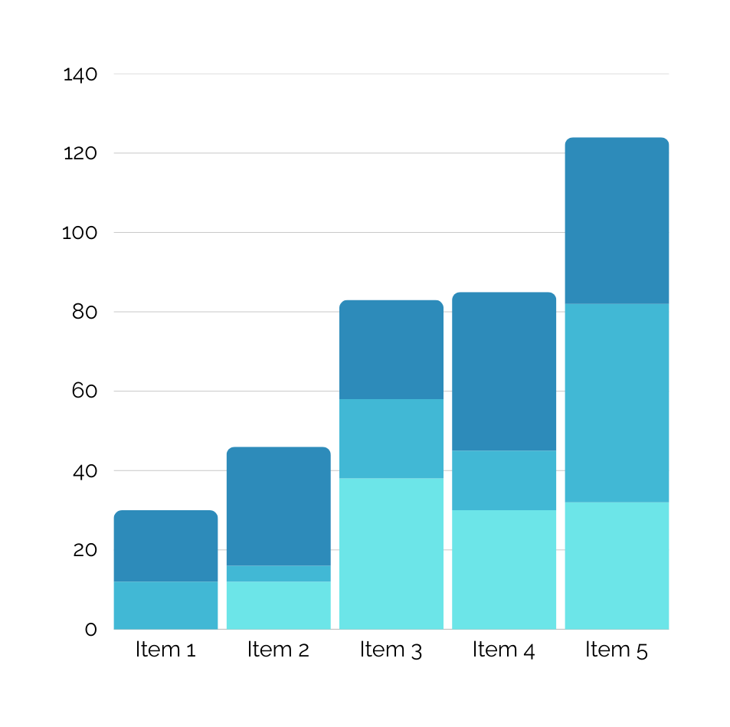
Target Market Opportunity
How big is the market your company is after?
Define your potential customers and the total size of your target market.
09

Slide 14

Traction/Milestones
Boost your business model by providing a proof of validation that your solution really works to solve the problem you have identified.
Milestone 1
Milestone 3
Milestone 5
Explain an event worth mentioning for your company.
Explain an event worth mentioning for your company.
Explain an event worth mentioning for your company.
Milestone 2
Milestone 4
Explain an event worth mentioning for your company.
Explain an event worth mentioning for your company.

Slide 15



The Team
Team Member
Team Member
Introduce the key members of your team. It's people investors often invest in.
Introduce the key members of your team. It's people investors often invest in.
Team Member
Introduce the key members of your team. It's people investors often invest in.
08

Slide 16
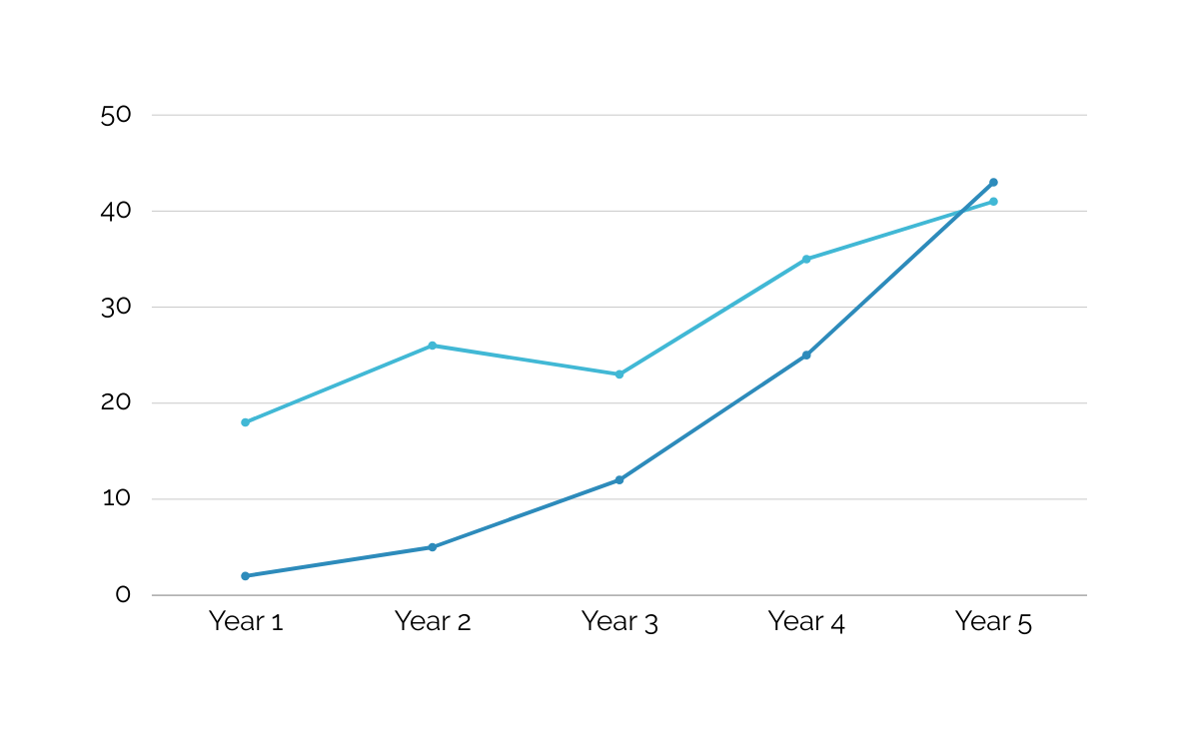
Financial Projections
Make it visual
Use charts to visually showcase your sales, total customers, total expenses, and net profits.
13

Slide 17
Use 1
Investors like to see that you have a plan. Explain how you expect to deploy the funds you are raising.
The Investment / Use of Funds
Use 2
Investors like to see that you have a plan. Explain how you expect to deploy the funds you are raising.
Finally, ask for the money. How much money are you seeking, and how are you planning to use it to achieve your business goals.
Use 3
Investors like to see that you have a plan. Explain how you expect to deploy the funds you are raising.
14

Slide 18

Thank You
Contact Information
www.hithere.com
hello@hithere.com
+917.123.123

